Slide 1

E-learning Center
Respected Advisor,
Syeda Sambul Hossain
Lecturer (Senior Scale)
Department of Software Engineering
Faculty of Science and Information Technology
Daffodil University
By Habibur Rahman Rifat
163-35-1722
Department of Software Engineering
Daffodil University

Slide 2
Introduction
Development is about growth and helping to grow different aspects, as together they create further growth. Development is vital in today's society as it affects every aspect in everyday life. For young generation, is it very important for their future. This is why we have developed a system that will help them excel their skills and help them find an ideal job through our web application. This is a very good opportunity for students to learn and develop themselves for future opportunities. This project also includes seminars to help inspire students and help them chase their dreams in the right direction.

Slide 3
Motivation
There are many students who due to lack of support cannot excel and are stuck and don’t know which way to go. Some become frustrated and stop trying and waste time on unnecessary things . Our goal is to make them capable and ready to build a perfect future. We bring all the information right to the users fingertips and they can go through them easily and save time and effort. In my personal experience , I feel looking for suggestions or career advice is very hard and misleading at times. So we build a successful web application to support young generation to excel.

Slide 4
Objective
Make a reliable platform for users to access information
Provide valid details and timetables about seminars and courses
Keep job portal up to date with so that students can get latest job updates
To make it easier for admins to work and upload data
UI must be user friendly

Slide 5
Features
Courses information
Seminars information
Job Portal information
Students Applications
Manage courses
Manage Jobs
Manage seminars
Applications view

Slide 6
Stakeholders
Admin
User

Slide 7
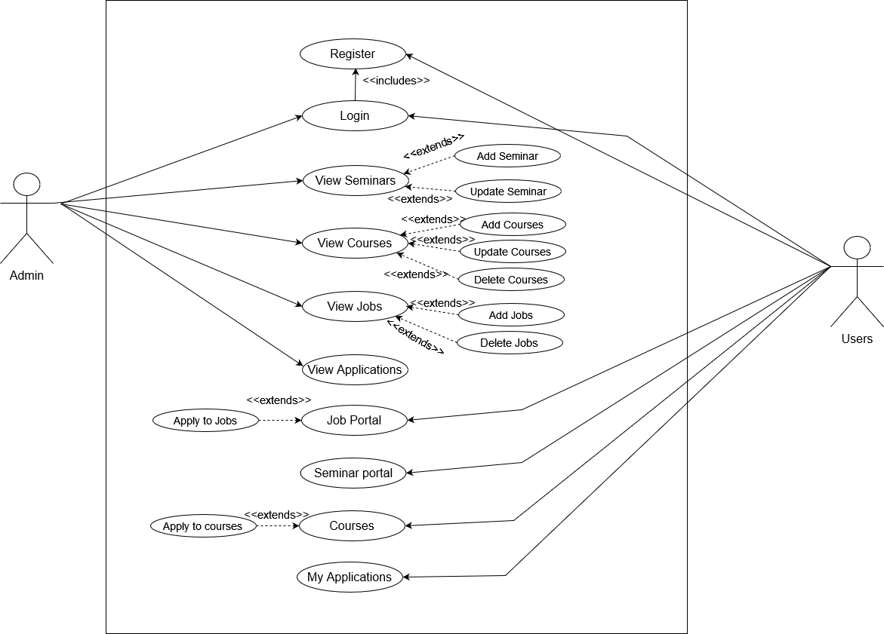
Use Case

Slide 8
Functional Requirements
Functional Requirement | Description | Stakeholder
Login | Admin can login to the system with email/name and password | Admin
View seminars | Admin views listed seminars in the system | Admin
Add Seminars | Admin adds seminars in the system | Admin
Update Seminars | Admin updates seminars in the system | Admin
View courses | Admin views listed courses in the system | Admin
Add courses | Admin adds courses in the system | Admin
Update courses | Admin updates courses in the system | Admin
Deletes courses | Admin deletes courses in the system | Admin
View Jobs | Admin views listed jobs in the system | Admin

Slide 9
Functional Requirement | Description | Stakeholder
Add jobs | Admin adds jobs in the system | Admin
Delete jobs | Admin deletes jobs in the system | Admin
View Applications | Admin views the users applications when posted in the system | Admin

Slide 10
Functional Requirements
Functional Requirement | Description | Stakeholder
Register | Users can register to the system with email , name and password to use the system | User
Login | User can login to the system with email and password | User
Job Portal | User can views listed jobs in the system | User
Apply to jobs | User can apply for any jobs listed in the system | User
Seminar Portal | User can views listed information about seminars in the system | User
Courses | User can views listed courses in the system | User
Apply to courses | User can apply for any courses listed in the system | User

Slide 11
Non-Functional Requirements
Performance
Reliability
Security
Maintainability
Usability

Slide 12

Activity Diagrams

Slide 13
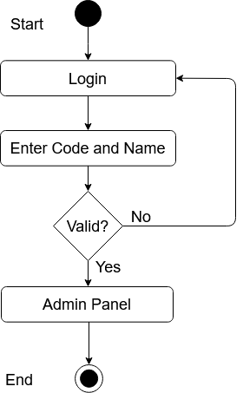
Admin-login

Slide 14
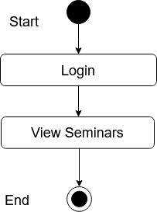
Admin-View Seminars

Slide 15
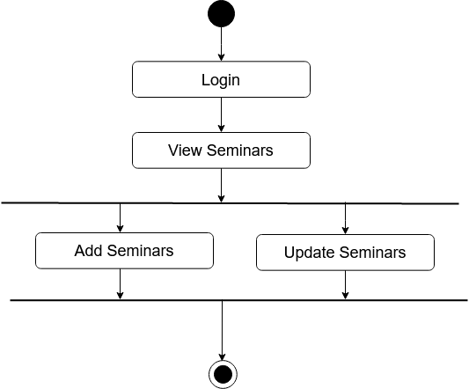
Admin-Add/update Seminar

Slide 16

Admin-View Courses

Slide 17
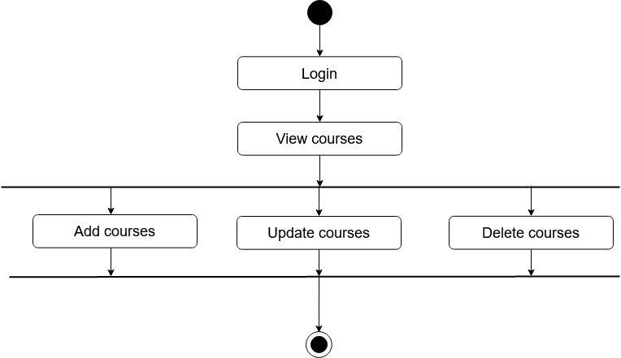
Admin-Add/Update/Delete Courses

Slide 18
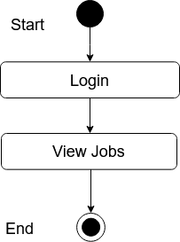
Admin-View Jobs

Slide 19

Admin-Add/Delete Jobs

Slide 20
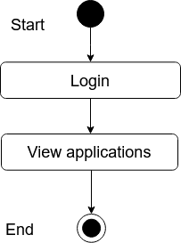
Admin-View Applications

Slide 21
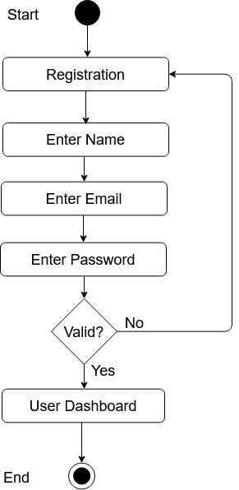
User-Registration

Slide 22
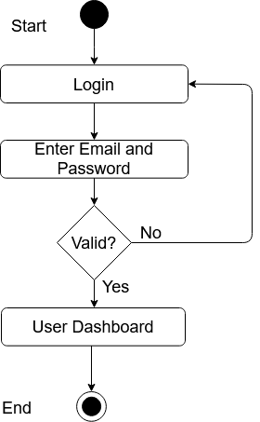
User-Login

Slide 23
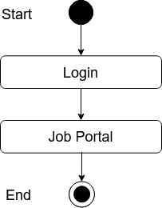
User-Job Portal

Slide 24
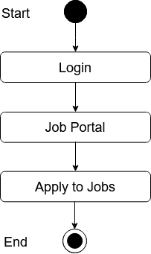
User-Job Apply

Slide 25
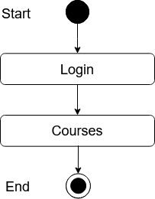
User-Courses

Slide 26
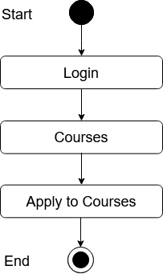
User-Course Apply

Slide 27
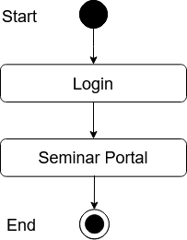
User-Seminars

Slide 28

My Applications

Slide 29
Sequence Diagrams

Slide 30
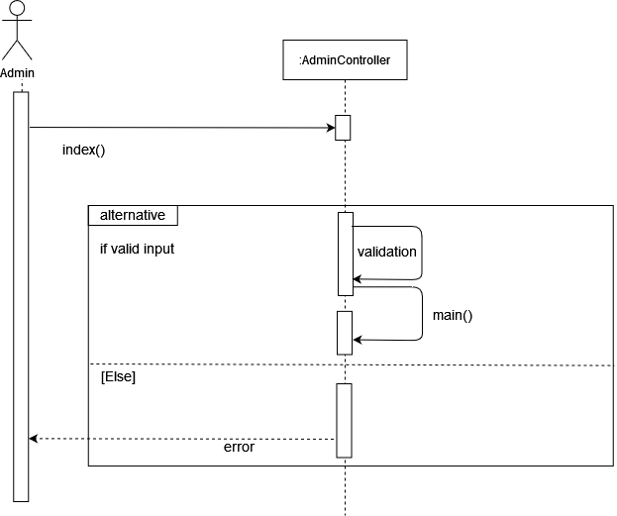
Admin-Login

Slide 31
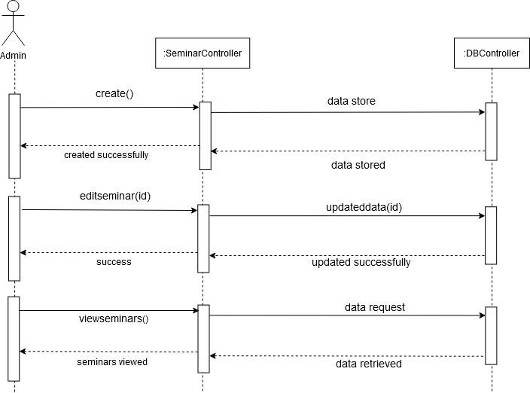
Admin-Seminar

Slide 32
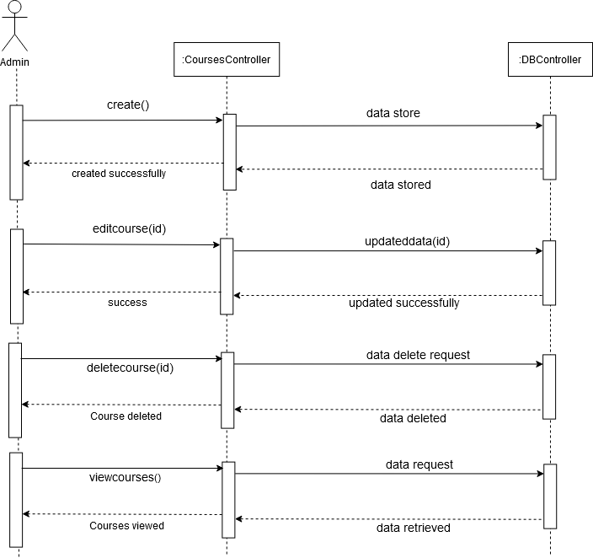
Admin-Courses

Slide 33
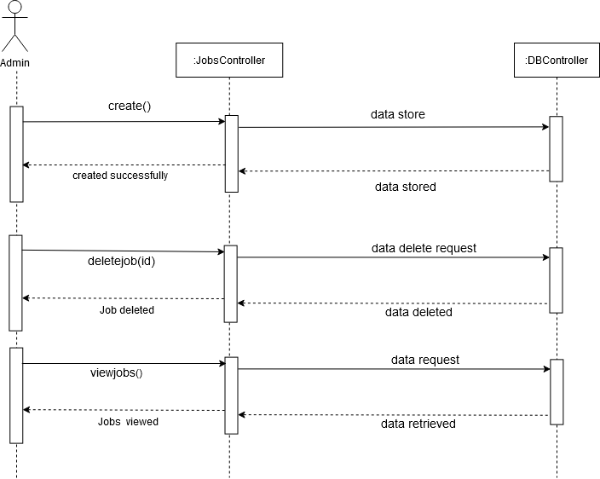
Admin-Jobs

Slide 34
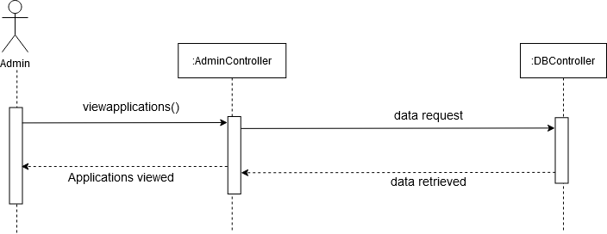
Admin-View Applications

Slide 35
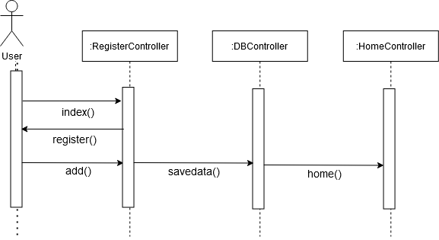
User-Registration

Slide 36
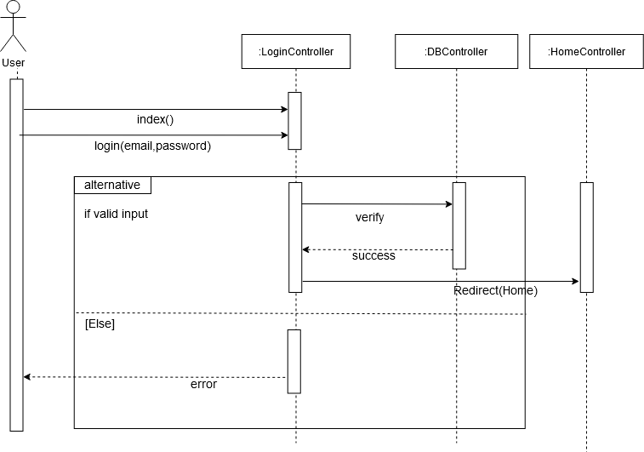
User-Login

Slide 37
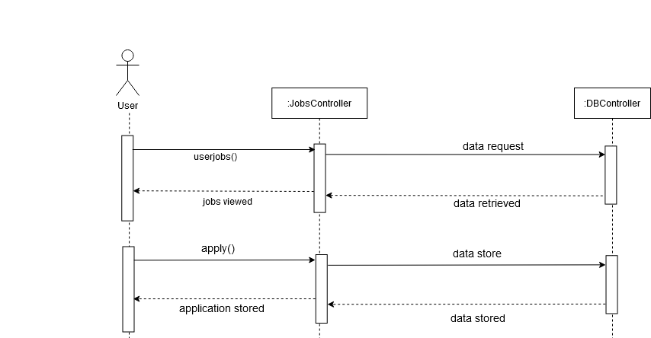
User-Job Portal

Slide 38
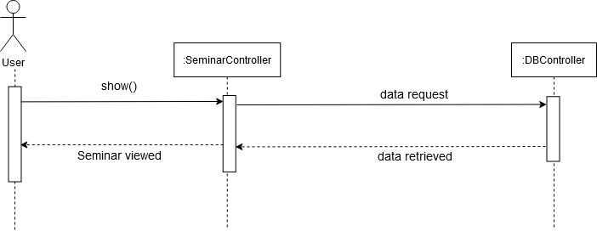
User-Seminar Portal

Slide 39
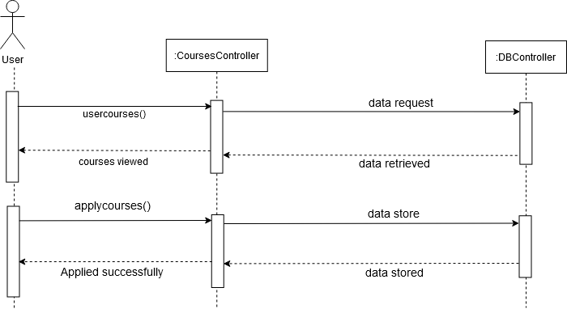
User- Courses

Slide 40
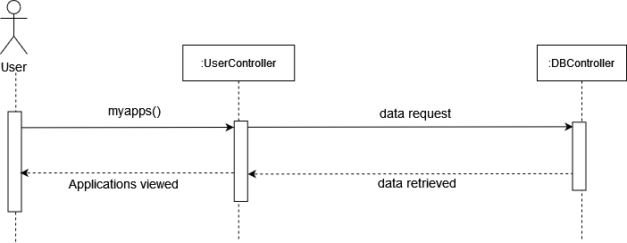
User- Courses

Slide 41
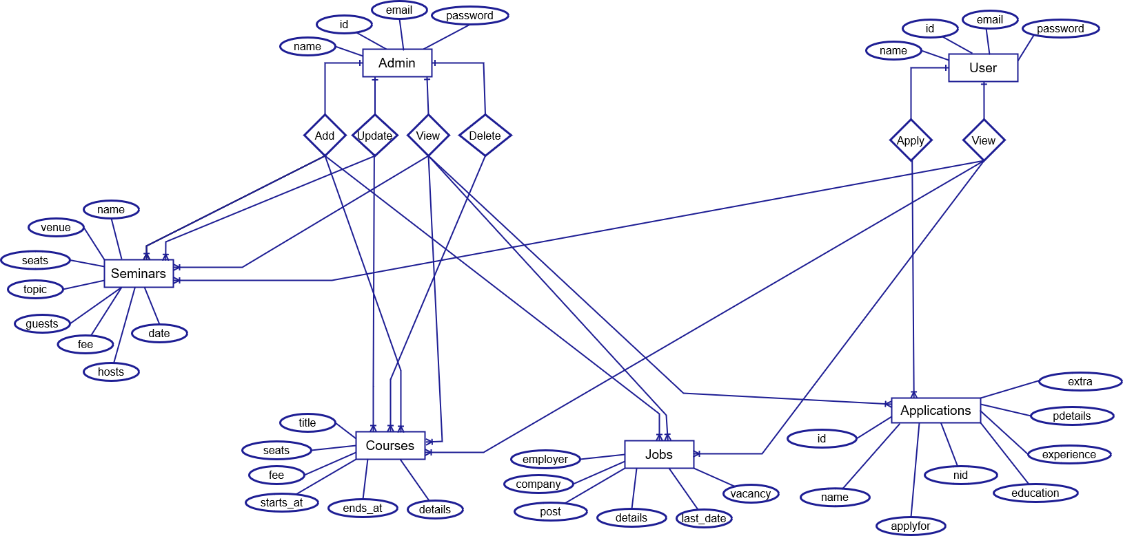
ER Diagram

Slide 42
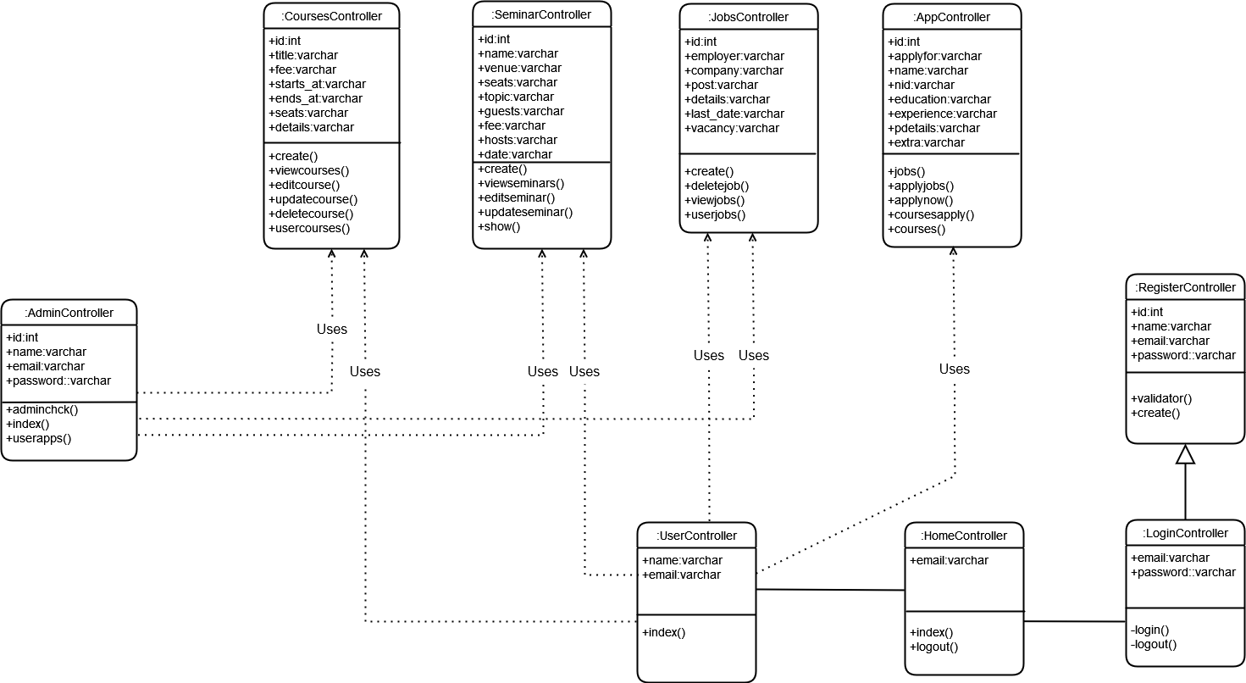
Class Diagram

Slide 43
Tools & Technologies
This project is developed in PHP framework Laravel 8
Using MySql Database
HTML,CSS,JS for frontend
PHP Storm for Coding
Windows 10 is the operating system

Slide 44


